Slide 1

Data science capstone project
Tanish Gupta
07/14/2024

Slide 2
Outline
Executive Summary
Introduction
Methodology
Results
Conclusion
Appendix

Slide 3

Executive Summary
Methodologies: -
Data Collection
Data Preparation
Exploratory Data Analysis (EDA)
Interactive Visual Analytics
Machine Learning Prediction
Results Compilation
Key Findings and Model Performance:
Developed four machine learning models: Logistic Regression, Support Vector Machine, Decision Tree Classifier, and K-Nearest Neighbors, achieving an average accuracy rate of approximately 83.33%.
All models consistently over-predicted successful landings, indicating a potential bias towards positive outcomes.
The analysis revealed that while current models perform adequately, acquiring more diverse data could further enhance model accuracy and reliability.

Slide 4
Introduction
Project background:-
SpaceX, leveraging the reusability of Falcon 9's first stage, offers rocket launches at $62 million—significantly cheaper than competitors' rates of $165 million. The capability to predict the successful landing of this first stage can directly influence cost estimations for launches. This project aims to develop a machine learning pipeline to forecast the likelihood of the first stage landing successfully, providing crucial competitive insights for companies looking to challenge SpaceX in the market
Problems:-
What are the critical factors that influence the successful landing of the rocket's first stage?
How do different variables interact to affect the success rate of the rocket's landing?
What specific operating conditions are essential to ensure a successful landing program?

Slide 5

Methodology

Slide 6
Methodology
Data Collection and Preparation: Data was sourced from the SpaceX API and supplemented through web scraping from Wikipedia. We conducted thorough data wrangling and applied one-hot encoding to transform categorical variables for analysis.
Exploratory and Interactive Analysis: Utilized SQL for exploratory data analysis and employed Folium and Plotly Dash for interactive visual analytics to derive deeper insights.
Predictive Modeling: Developed and fine-tuned various classification models to predict the success of rocket landings. The process involved building, tuning, and evaluating each model to optimize performance

Slide 7
Data Collection
Data was gathered through multiple methods:
Utilized GET requests to access the SpaceX API.
The response content was then converted into a JSON format using the .json() function, and subsequently transformed into a pandas dataframe with the help of .json_normalize().
The dataset underwent cleaning processes, including identifying and addressing missing values.
Additionally, web scraping was conducted on Wikipedia to obtain Falcon 9 launch records using BeautifulSoup.
This involved extracting launch records presented in HTML tables, parsing these tables, and converting them into a pandas dataframe for subsequent analysis.

Slide 8
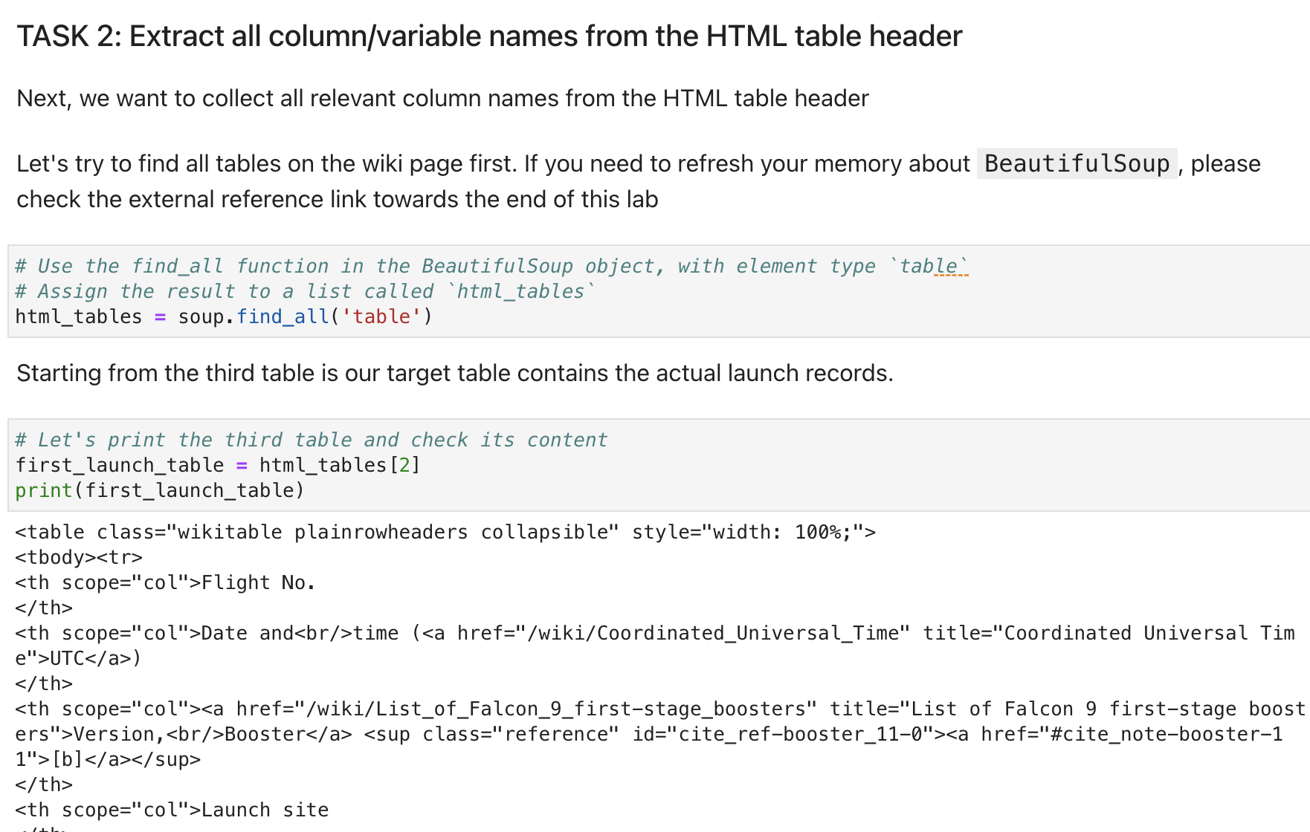
Data Collection - Scraping
We utilized web scraping to extract Falcon 9 launch records using BeautifulSoup.
We processed the table and transformed it into a pandas dataframe.

Slide 9
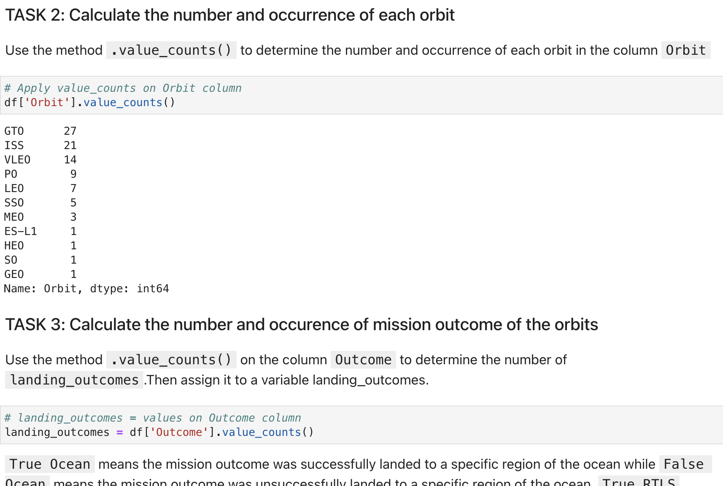
Data Wrangling
We conducted exploratory data analysis and established the training labels. We computed the total launches at each site and analyzed the frequency of each orbit. Additionally, we generated a landing outcome label from the outcome column and exported the results to a CSV file.

Slide 10
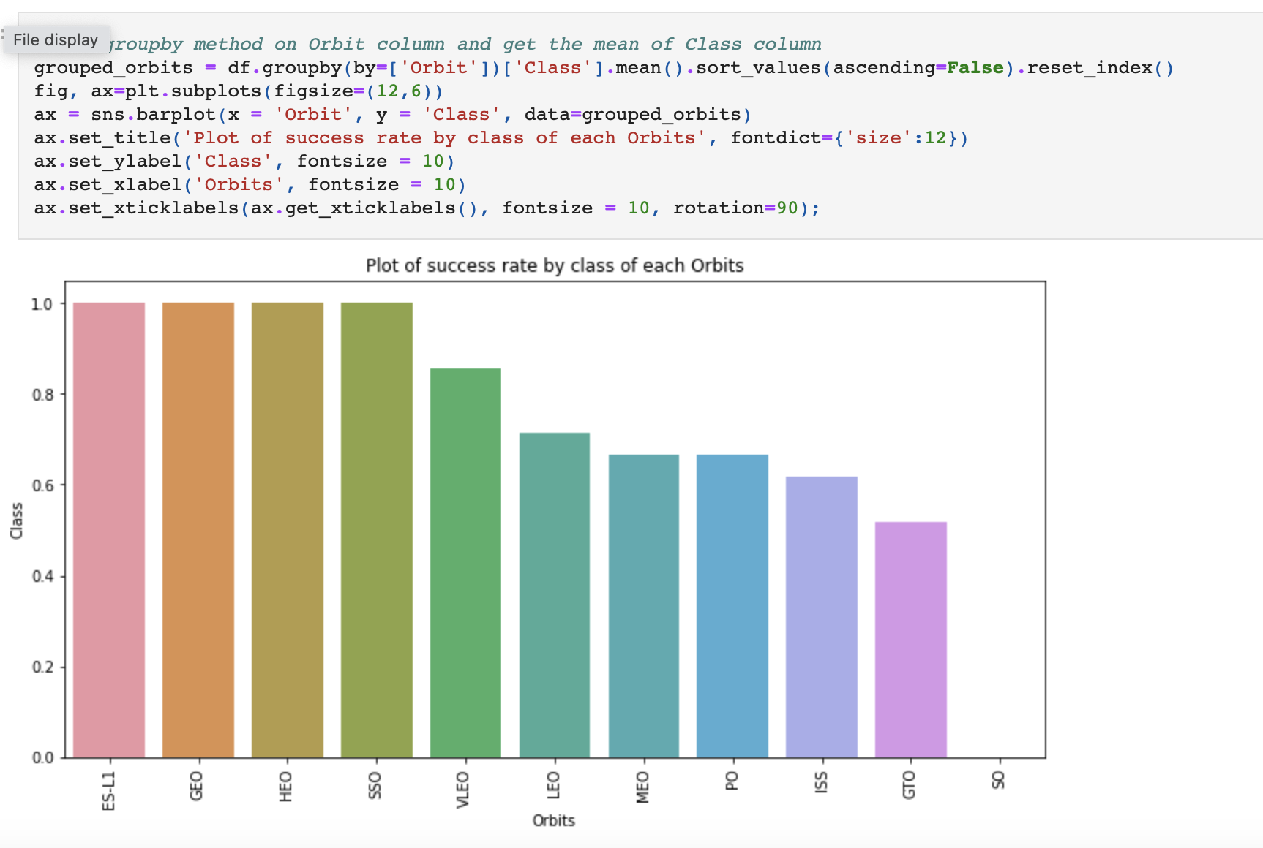
EDA with Data Visualization
Plots Used:
Flight Number vs. Payload Mass, Flight Number vs. Launch Site, Payload Mass vs. Launch Site, Orbit vs. Success Rate, Flight Number vs. Orbit, Payload vs Orbit, and Success Yearly Trend
Scatter plots, line charts, and bar plots were used to compare relationships between variables to
decide if a relationship exists so that they could be used in training the machine learning model
We analyzed the data by examining the correlations between various parameters. Specifically, we visualized the relationships between flight number and launch site, payload mass and launch site, and success rates across different orbit types. Additionally, we explored connections between flight number and orbit type and tracked the yearly trends in launch success.

Slide 11
EDA With sql
Loaded data set into IBM DB2 Database.
Queried using SQL Python integration.
Queries were made to get a better understanding of the dataset.
Queried information about launch site names, mission outcomes, various pay load sizes of customers and booster versions, and landing outcomes
We applied EDA with SQL to get insight from the data. We wrote queries to find out for instance:
The names of unique launch sites in the space mission.
The total payload mass carried by boosters launched by NASA (CRS)
The average payload mass carried by booster version F9 v1.1
The total number of successful and failure mission outcomes
The failed landing outcomes in drone ship, their booster version and launch site names
The link of notebook:- https://github.com/tanishtg/Data-Science/blob/main/Applied_Data_Science_Capstone/jupyter-labs-eda-sql-coursera_sqllite.ipynb

Slide 12
Build an Interactive Map with Folium
We plotted all launch sites on a Folium map, incorporating map objects such as markers, circles, and lines to denote the success or failure of launches at each location.
We categorized launch outcomes into two classes: 0 for failure and 1 for success.
By using color-labeled marker clusters, we identified which launch sites exhibited relatively high success rates.
We also measured the distances from each launch site to nearby features, addressing questions such as: Are launch sites close to railways, highways, and coastlines? and Do launch sites maintain a certain distance from cities?

Slide 13
Build a Dashboard with Plotly Dash
Dashboard features a pie chart and a scatter plot.
The pie chart provides options to view the distribution of successful landings both collectively across all launch sites and individually by site.
The scatter plot allows selections between all sites or specific sites and includes a slider to adjust the payload mass range from 0 to 10,000 kg.
This pie chart effectively illustrates the success rates at each launch site, while the scatter plot aids in examining how success varies with launch site, payload mass, and booster version.

Slide 14
Predictive Analysis (Classification)
We imported the data using numpy and pandas, processed the data, and divided it into training and testing sets.
We constructed various machine learning models and optimized numerous hyperparameters via GridSearchCV.
Accuracy served as the evaluation metric for our models, which we enhanced through feature engineering and algorithm optimization.
Ultimately, we identified the highest-performing classification model.

Slide 15
Results
Exploratory data analysis results
Interactive analytics demo in screenshots
Predictive analysis results
Preview of the Plotly dashboard.
The following sides will show the results of EDA with visualization, EDA with SQL, Interactive Map with Folium, and finally the results of our model with about 83% accuracy.

Slide 16

EDA Visualization

Slide 17
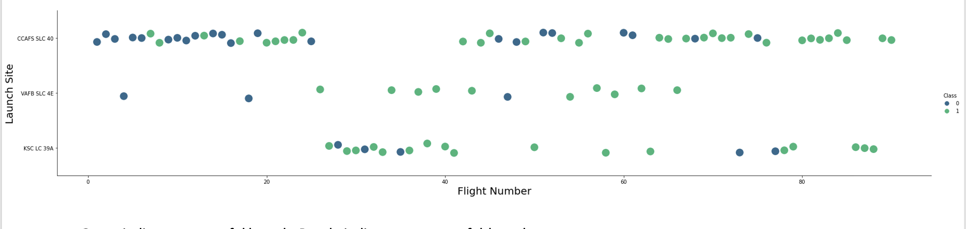
Flight Number vs. Launch Site
The Graph revealed that higher flight volumes at a launch site are associated with increased success rates at that site

Slide 18
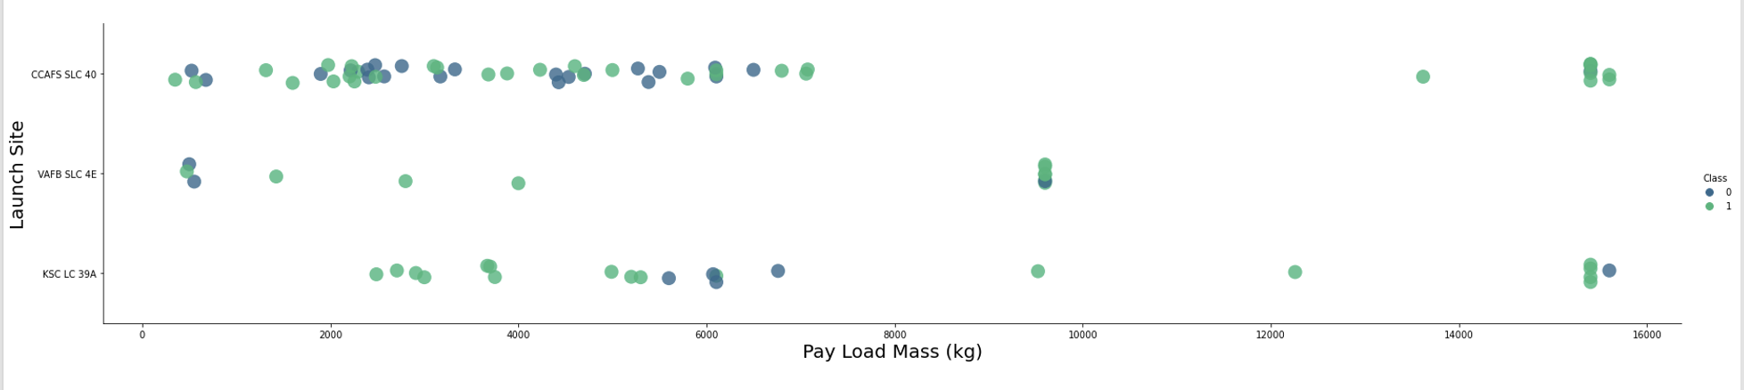
Payload vs. Launch Site
Greater the payload mass for launch site the higher the rate of success

Slide 19
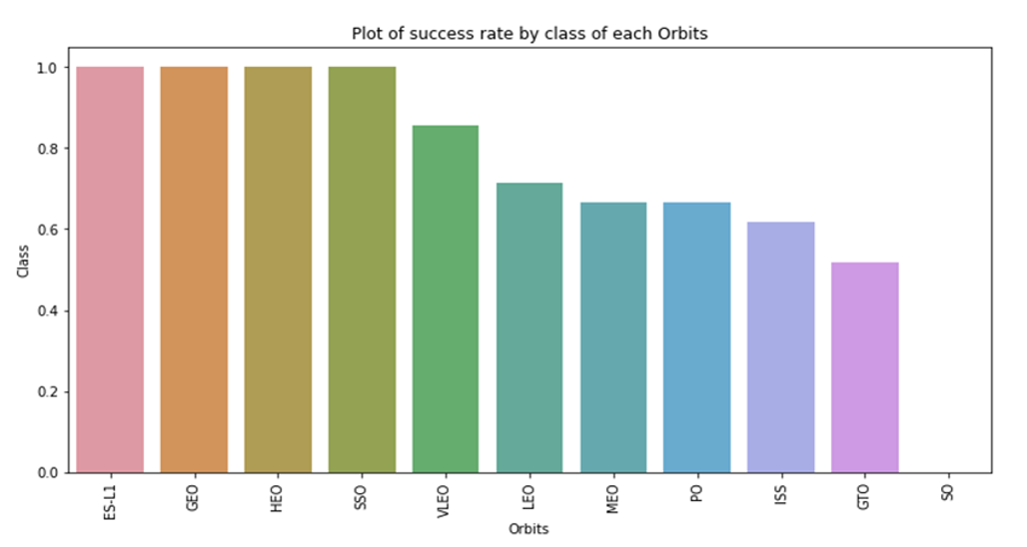
Success Rate vs. Orbit Type
This graph shows the success rate of satellite launches into different orbits, with ES-L1 and GEO orbits having the highest success rates. The graph can help in understanding which orbits have historically been more reliable for successful missions

Slide 20
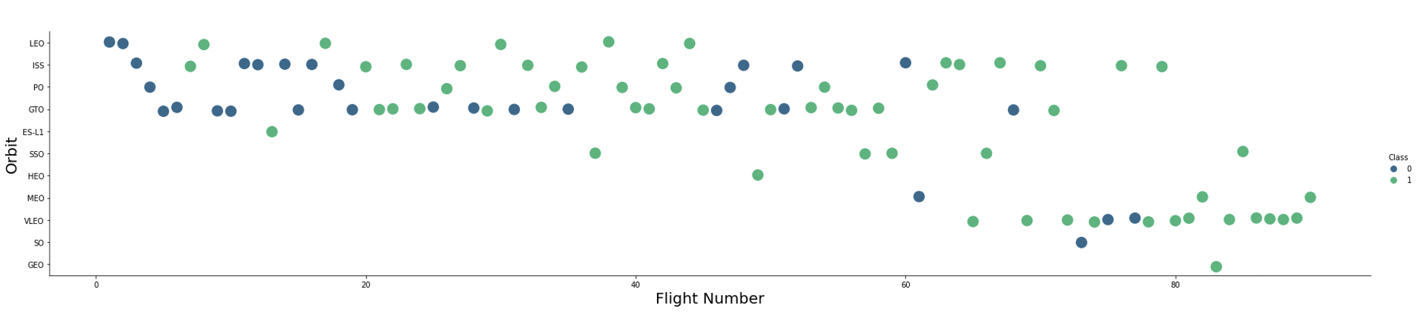
Flight Number vs. Orbit Type
The scatter plot displays SpaceX flight numbers against various orbit types, color-coded by class—green for success (1) and blue for failure (0). It shows a general trend of increasing success rates as flight numbers progress, particularly noticeable in the LEO and ISS orbits where early flights exhibit more failures and recent flights are predominantly successful

Slide 21
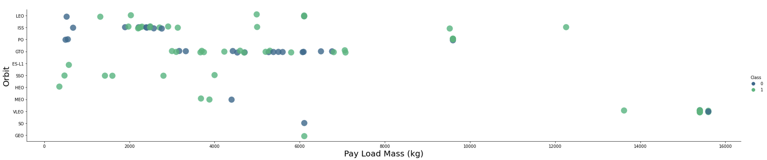
Payload vs orbit type
The scatter plot correlates payload mass with orbit types for SpaceX launches, showing a trend where higher payload masses generally have higher success rates (green), especially noticeable in orbits like VLEO and ES-L1.

Slide 22
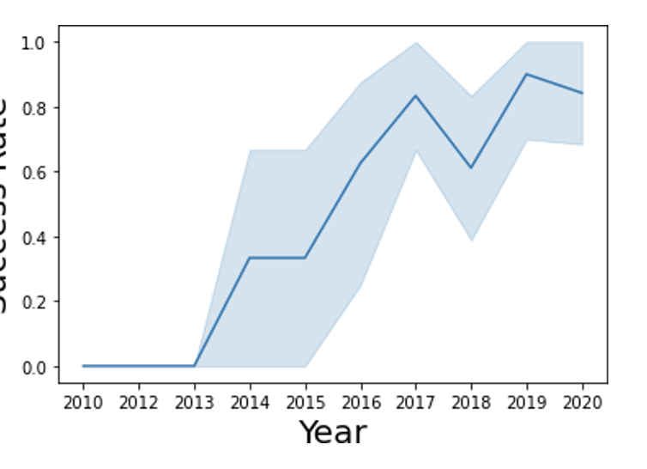
Launch Success Yearly Trend
The line graph illustrates a significant upward trend in SpaceX's launch success rate from 2010 to 2019, peaking near 2018 before a slight decline into 2020.

Slide 23

EAD with sql

Slide 24
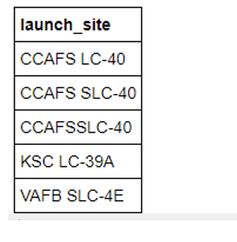
All Launch Site Names
CCAFS SLC-40 and CCAFSSLC-40 likely all represent the same
launch site with data entry errors
only 3 unique launch_site values:
CCAFS SLC-40, KSC LC-39A, VAFB SLC-4E

Slide 25
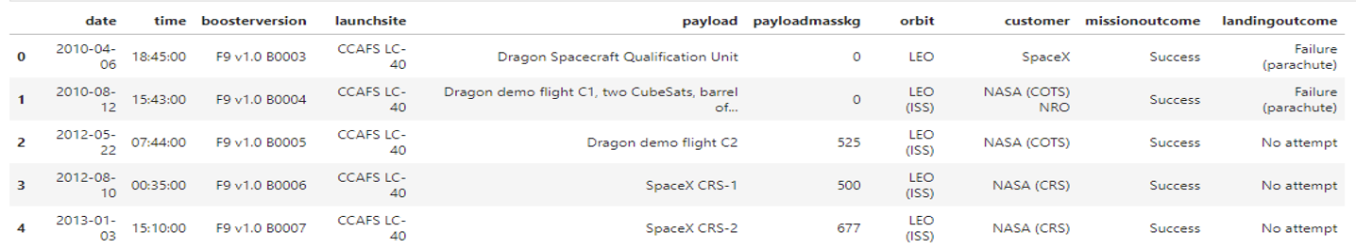
Launch Site Names Begin with 'CCA'
the first five records from the database where the Launch Site name starts with "CCA."

Slide 26
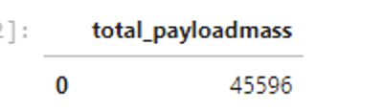
Total payload mass
After running the query for sum of the total payload mass in kg where NASA was the customer.
CRS stands for Commercial Resupply Services which indicates that these payloads were sent to the International Space Station (ISS).

Slide 27
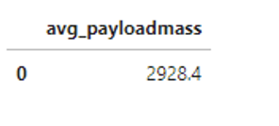
average payload mass by f9v1.1
After running the query to calculate average payload mass or launches which used booster version f9 v1.1

Slide 28
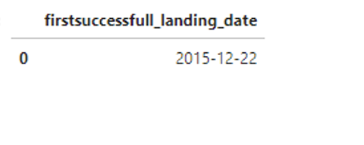
First Successful Ground Landing Date
First successful landing date on ground was Dec 22, 2015

Slide 29
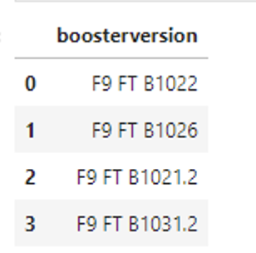
Successful drone ship landing with payload between 4000 and 6000
After running the query we got four booster version that successful drone ship landing which has payload mass between 4000 and 6000.

Slide 30
Total number of successful and failure mission outcomes
SpaceX successfully completes its missions nearly 99% of the time, suggesting that most landing failures are planned.
Notably, one launch has an ambiguous payload status, and regrettably, another experienced an in-flight failure.

Slide 31
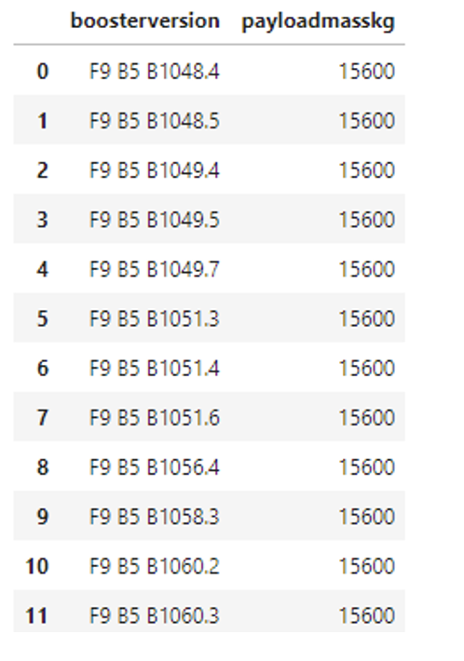
Boosters Carried Maximum Payload
After running the query we get the booster versions that carried the highest payload (1500 kg)
The version of the booster are similar and all are F9 B5

Slide 32
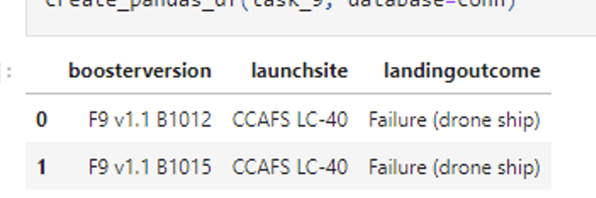
Failed 2015 Drone ship Landing
We run the query which return the landing outcome, booster version, payload mass and launch site and we got 2 value I result.

Slide 33
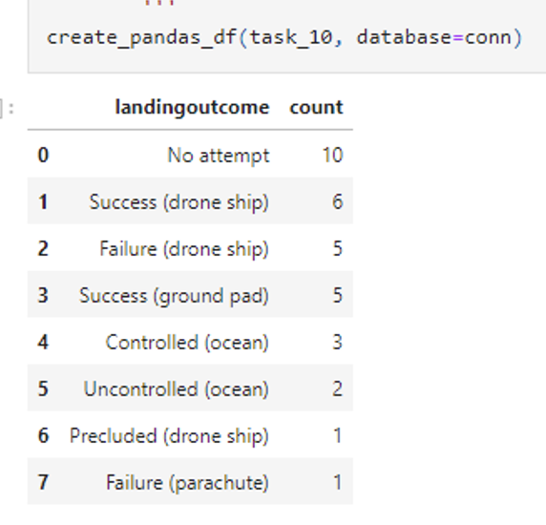
Rank Landing Outcomes Between 2010-06-04 and 2017-03-20
After selecting landing outcomes and their counts, applying a WHERE clause to filter records from March 20, 2010, to June 4, 2010. Then grouped the data by landing outcomes using the GROUP BY clause and sorted the groups in descending order with the ORDER BY clause

Slide 34

Launch Sites Analysis

Slide 35
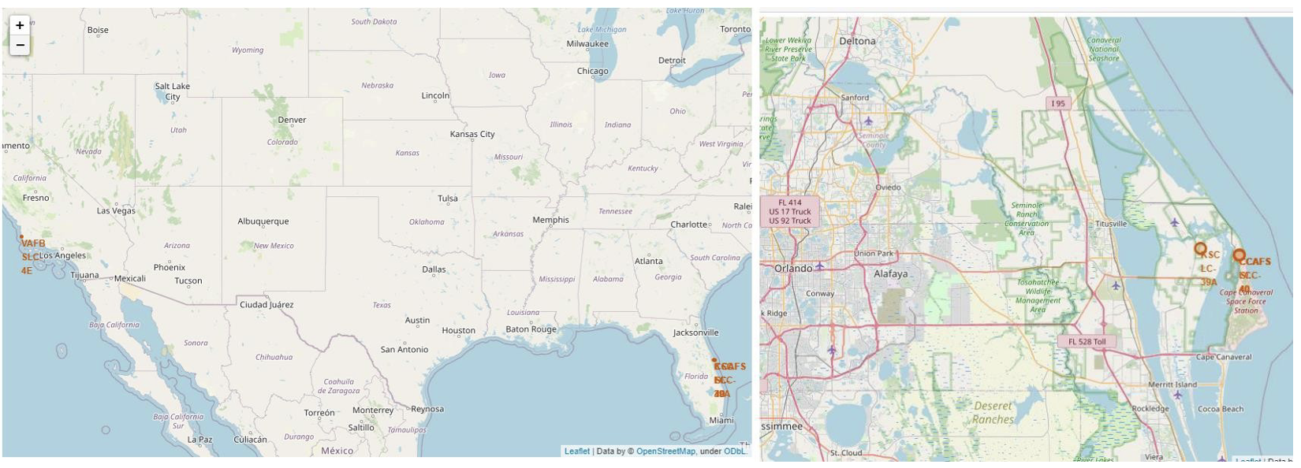
Launch site location
We can see the launch sites. All sites are near ocean

Slide 36
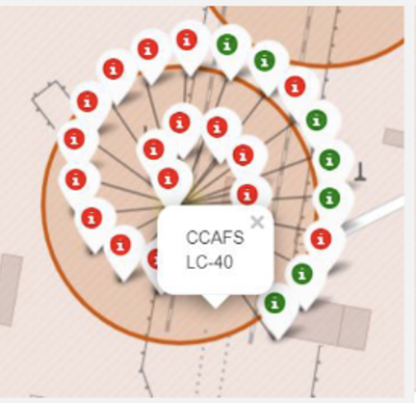
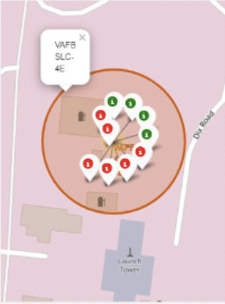
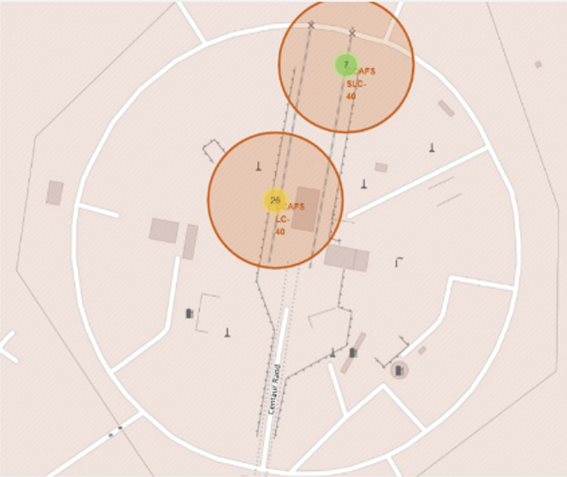
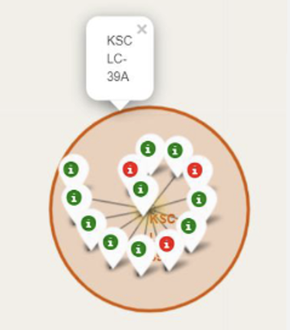
Launch site with color label

Slide 37
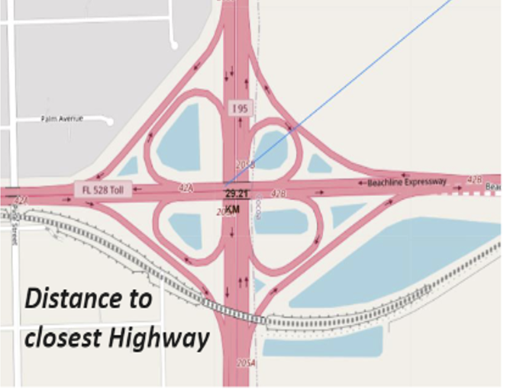
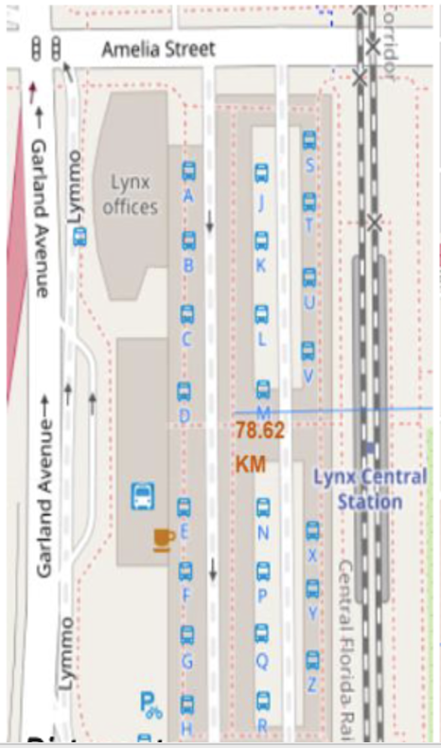
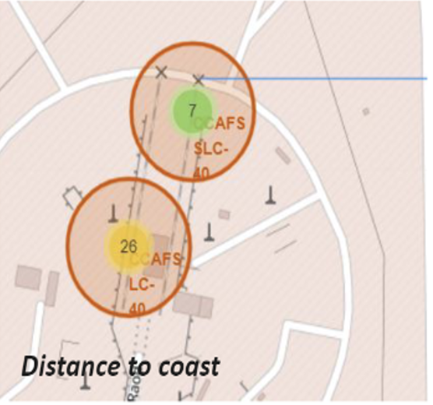
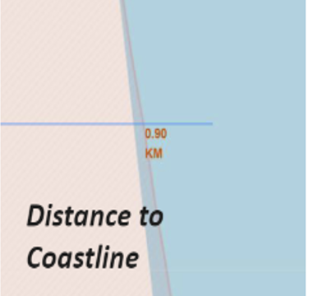
Launch site
We can see the lunch sites are near coastline

Slide 38

Build dashboard with ploty dash

Slide 39
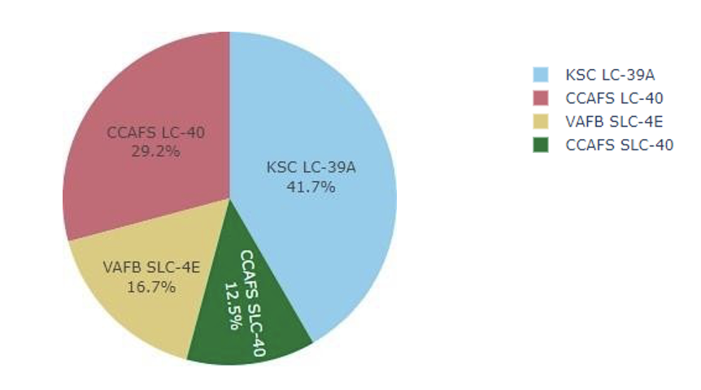
The chart showing the percentage achieved by each launch site
We can see the KSC LC-39 has most successful launches followed by CCAFS LCC-40 site

Slide 40
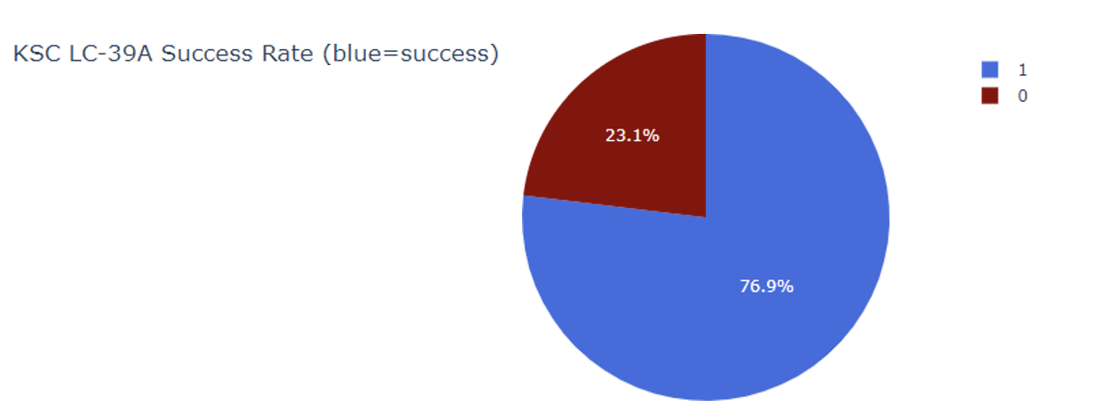
Highest success rate launch site
KSC LC-39A has the highest success rate with 10 successful landings and 3 failed landings

Slide 41
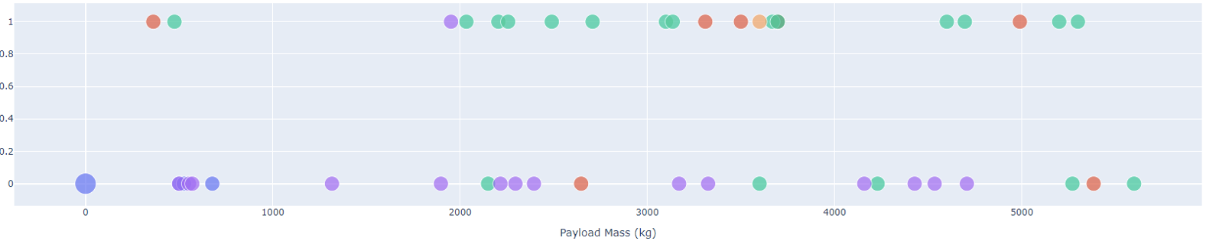
Payload vs Launch Outcome for all sites, with different payload selected in the range slider

Slide 42

Predictive analysis (classification)

Slide 43
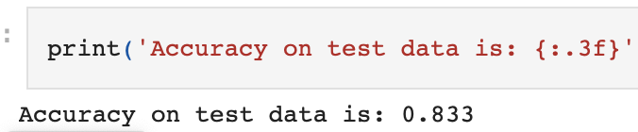
Classification accuracy
All models achieved a similar accuracy of 83.33% on the test set, which is notable given the small sample size of only 18.
This limited size can lead to significant fluctuations in accuracy results, as observed with the Decision Tree Classifier across multiple runs.
More data is needed to reliably determine the most effective model.

Slide 44
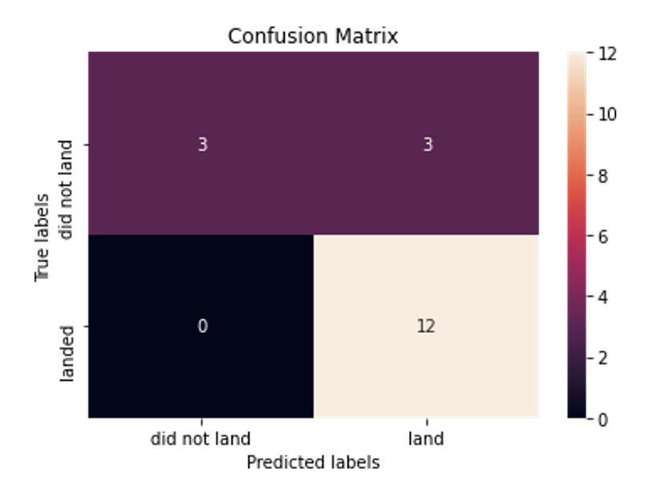
Confusion matrix
The confusion matrix for the decision tree classifier indicates it distinguishes between classes with a significant issue of false positives, where unsuccessful landings are incorrectly marked as successful. Across all models, the matrix remains consistent, predicting 12 true successful landings, 3 true unsuccessful landings, and 3 unsuccessful landings falsely labeled as successful, suggesting a tendency of the models to over-predict successful outcomes.

Slide 45
conclusion
The larger the flight amount at a launch site, the greater the success rate at a launch site.
Analysis also reveals a direct correlation between the number of flights at a launch site and its success rate, with sites like KSC LC-39A exhibiting the highest number of successful launches.
The decision tree classifier emerged as the most effective algorithm for this dataset, achieving an accuracy of 83% in predicting the successful landing of Stage 1.
Certain orbits, specifically ES-L1, GEO, HEO, SSO, and VLEO, consistently show higher success rates, which could guide future launch planning.

